Slide 1

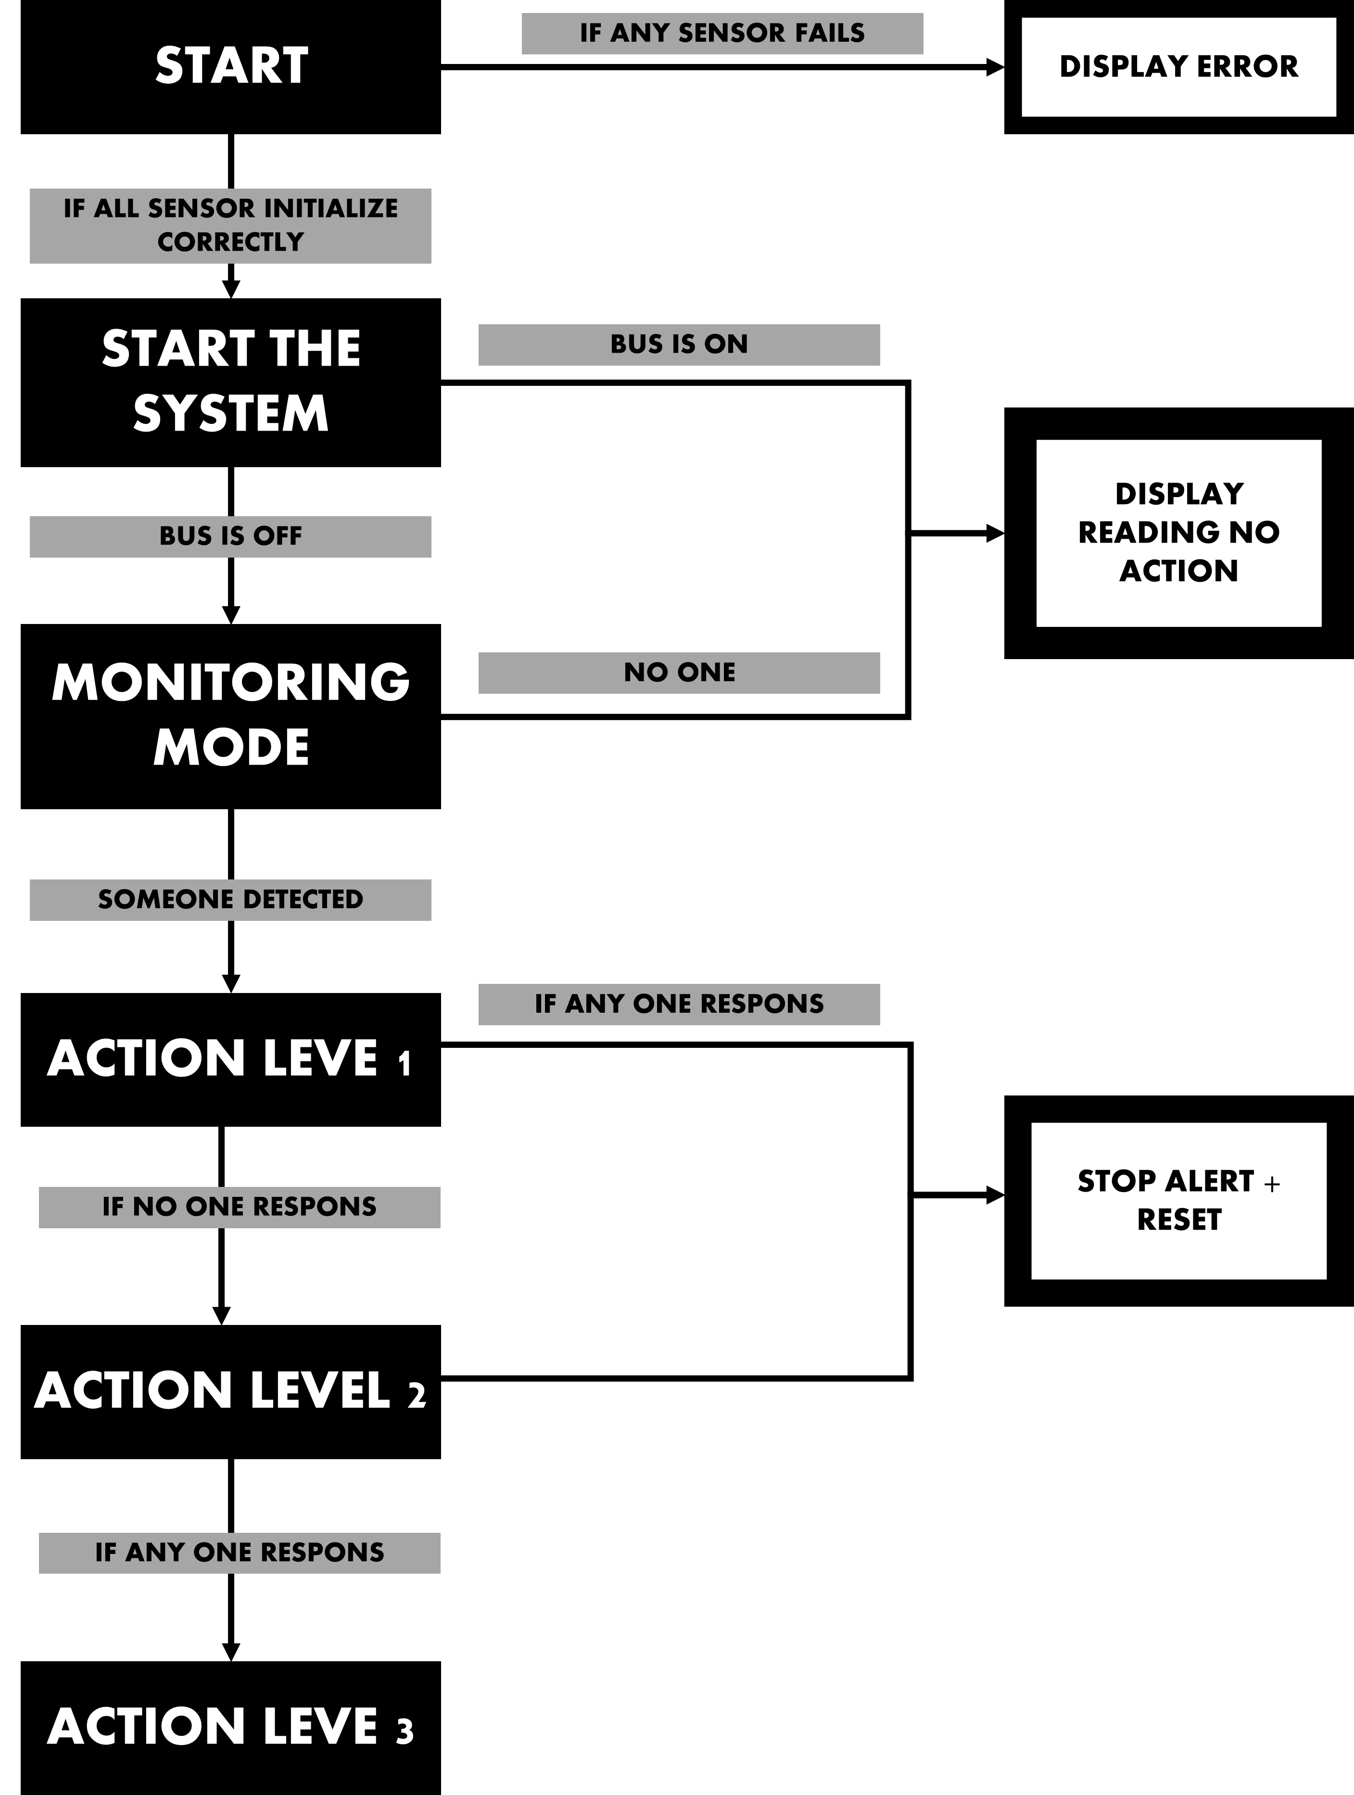
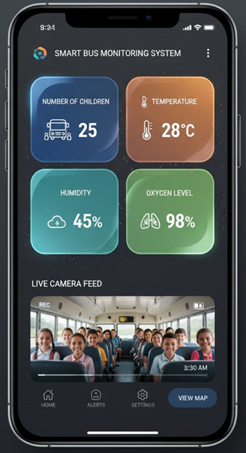
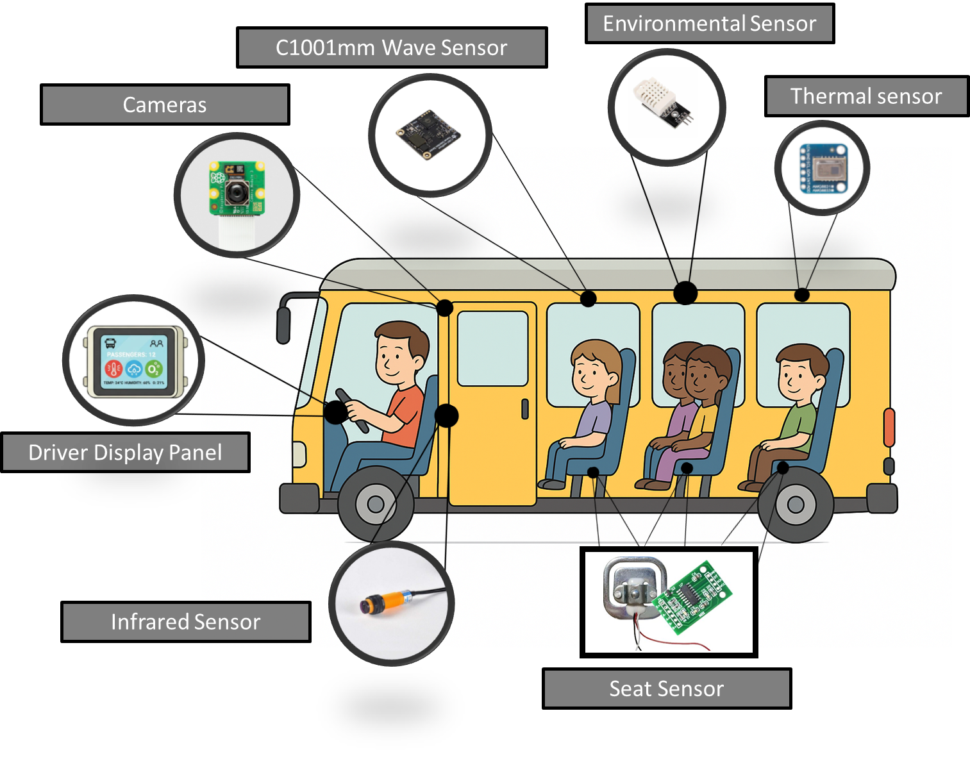
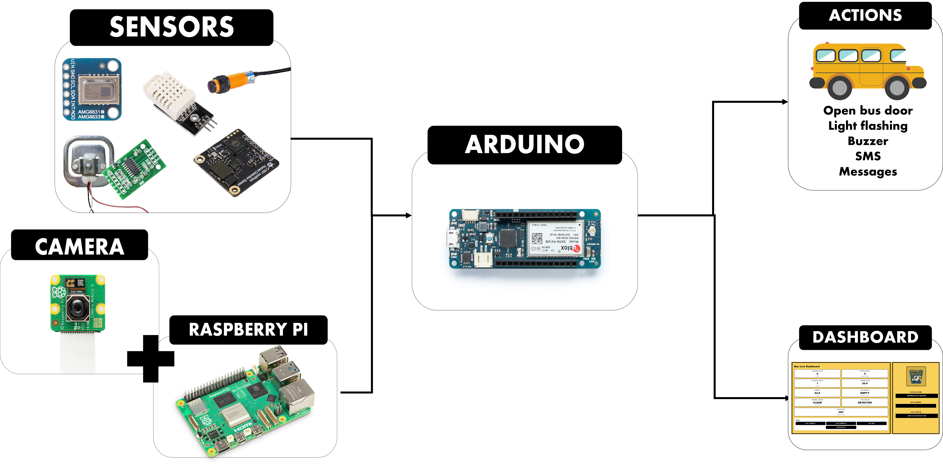
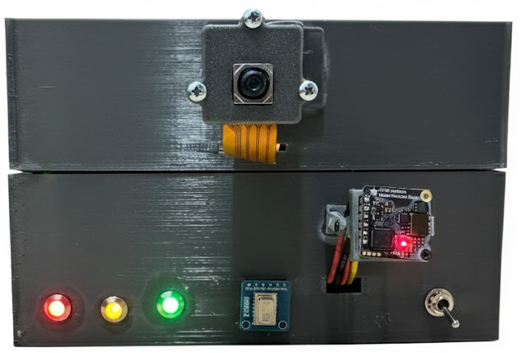
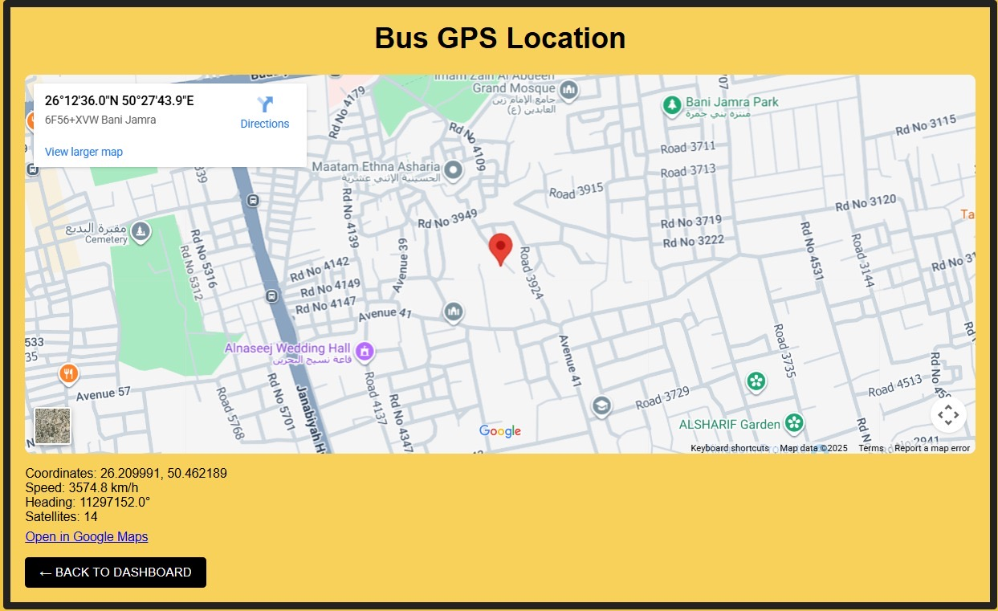
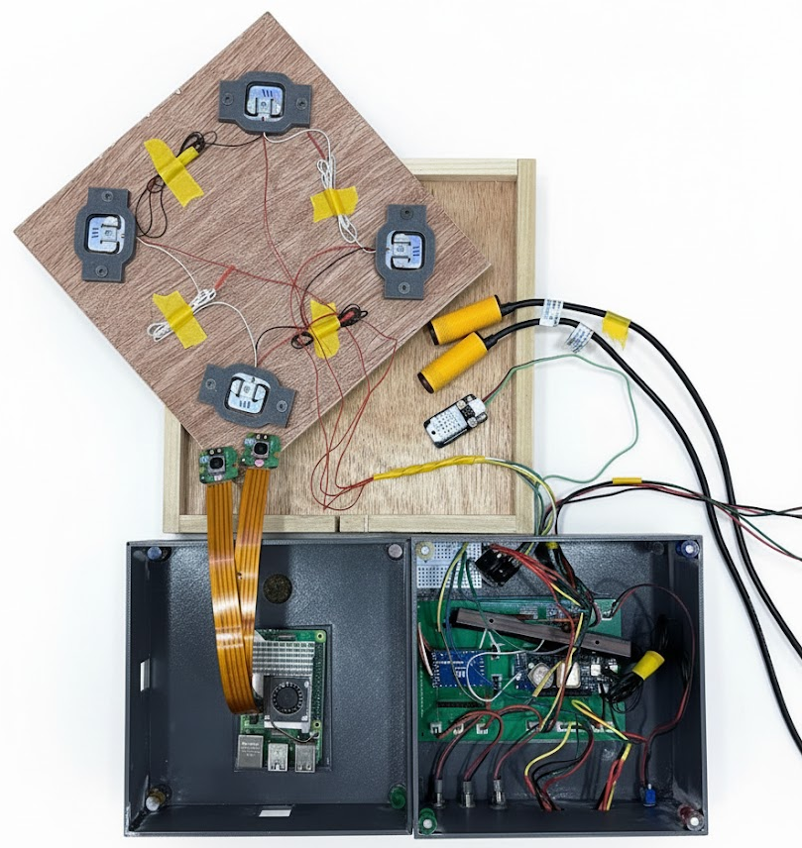
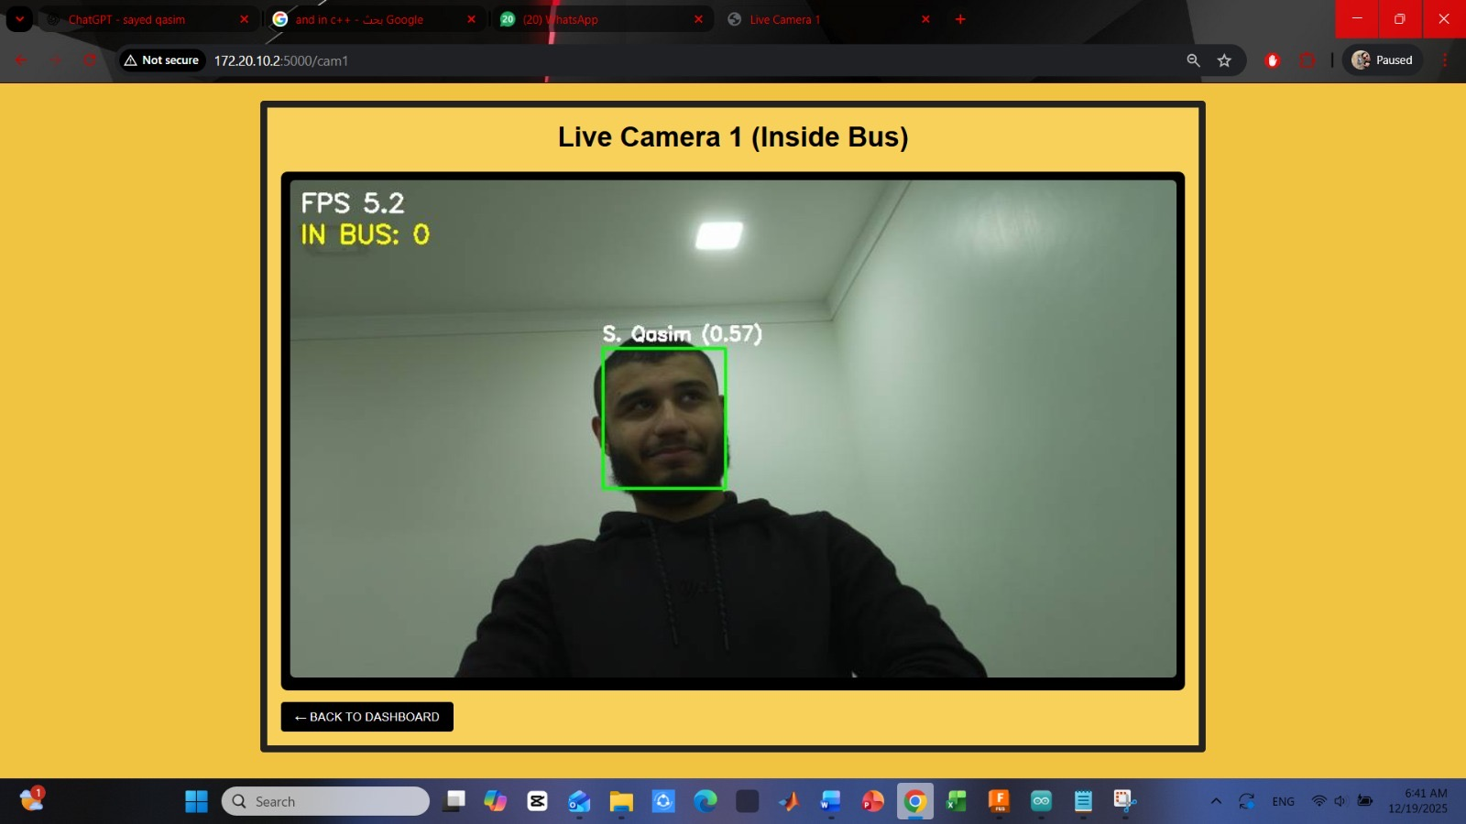
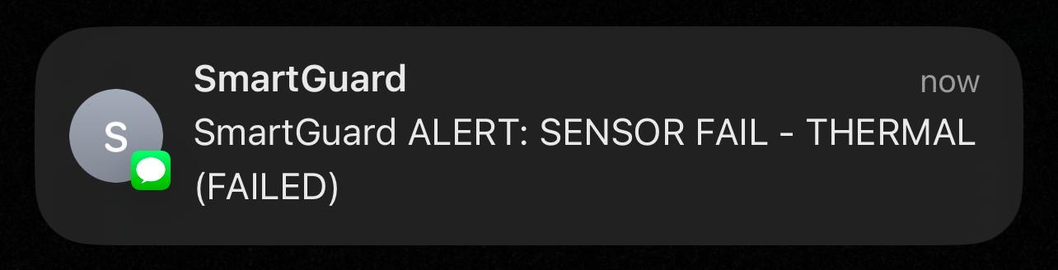
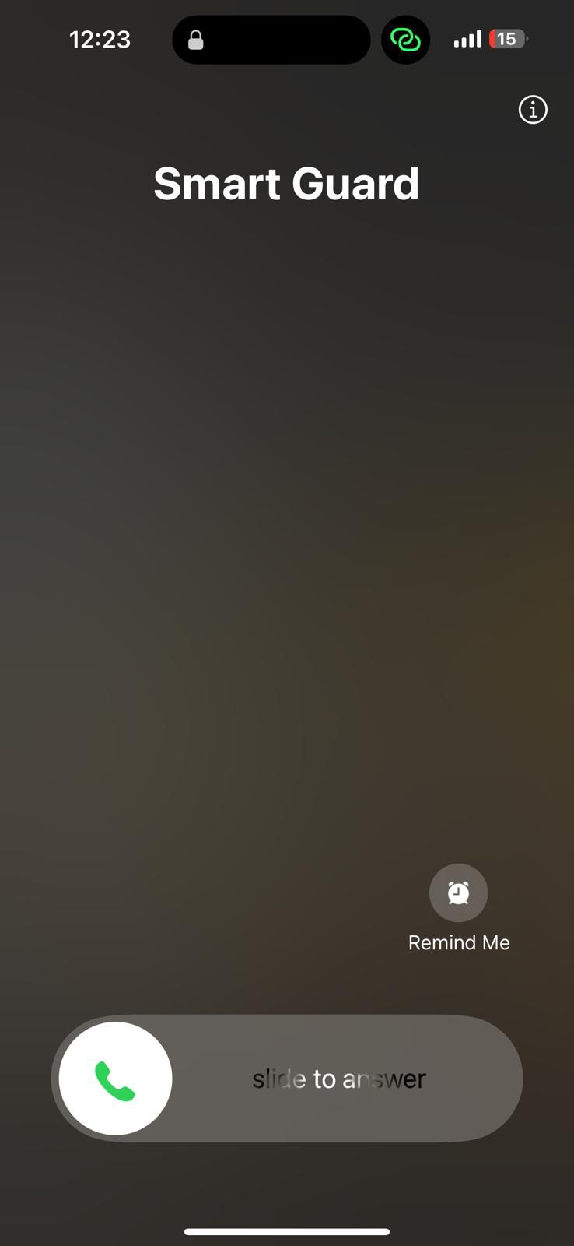
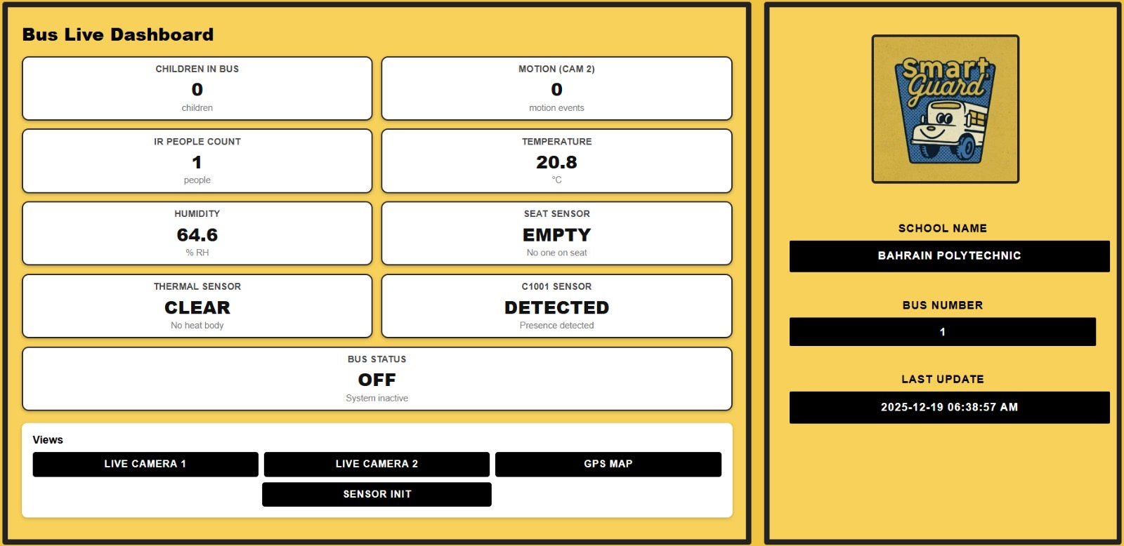
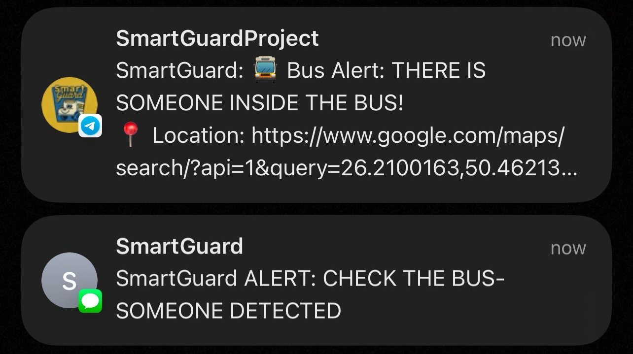
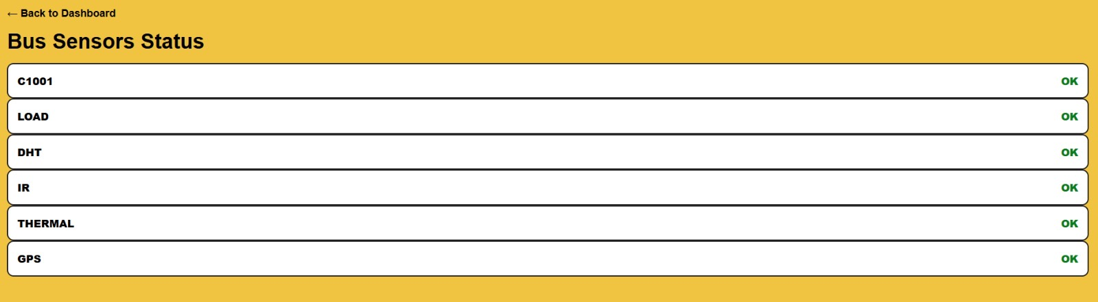
SmartGuard:
An Intelligent Child Safety and Monitoring System in Buses
Student: Mohamed Alaraibi-202101014 | Rahim Alrahim-202101849 | Reem Madan-201901611 | Sayed Qasim Fadhul-202101072
Polytechnic Supervisor: Dr. Zakareya Hasan
1. Introduction
4. Methodology
Ensuring child safety in school transportation remains a major challenge, particularly where safety procedures rely heavily on manual supervision. Incidents involving children being unintentionally left inside school buses have highlighted the limitations of human-dependent checks and the serious risks associated with delayed detection.
SmartGuard is an intelligent child safety and monitoring system designed to address these challenges through continuous automated surveillance. By integrating multi-sensor detection, vision-based monitoring, and real-time alerts, the system enables early risk identification and rapid response, significantly enhancing safety in school transportation.
Design & modeling
2. Problem Statement
School transportation safety relies heavily on manual supervision, making it vulnerable to human error and oversight.
Existing systems lack continuous monitoring and real-time child presence detection.
Automated emergency response mechanisms are not sufficiently implemented.
These limitations can result in dangerous situations remaining unnoticed, increasing safety risks.
Fabrication
3. Objectives
To continuously monitor child presence inside school buses.
To detect unsafe conditions using integrated sensing technologies.
To trigger real-time alerts and automated safety actions.
To reduce human error and enhance overall transportation safety.
5. Experimentation
Experimental Setup
Results
6. Conclusions
SmartGuard provides an effective solution for enhancing child safety in school transportation. The system successfully detects child presence and hazardous conditions while triggering timely alerts. Experimental results demonstrate reliable performance under different scenarios. Overall, SmartGuard reduces reliance on manual supervision and improves transportation safety.
Department of Electrical Engineering, Faculty of Engineering

